Slide 1
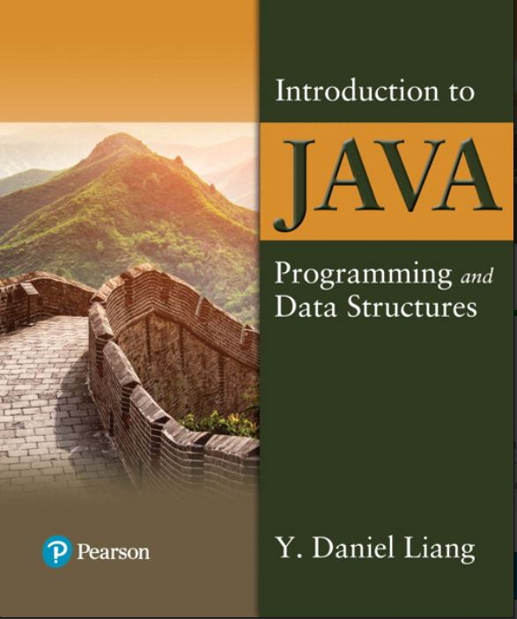

Introduction to Java Programming and Data Structures
Twelfth Edition
Chapter 20
Lists, Stacks, Queues, and Priority Queues
Copyright © 2020 Pearson Education, Inc. All Rights Reserved
Notes:
If this PowerPoint presentation contains mathematical equations, you may need to check that your computer has the following installed:
1) MathType Plugin
2) Math Player (free versions available)
3) NVDA Reader (free versions available)
Slides in this presentation contain hyperlinks. JAWS users should be able to get a list of links by using INSERT+F7

Slide 2
Objectives (1 of 2)
20.1 To explore the relationship between interfaces and classes in the Java Collections Framework hierarchy (§20.2).
20.2 To use the common methods defined in the Collection interface for operating collections (§20.2).
20.3 To use the Iterator interface to traverse the elements in a collection (§20.3).
20.4 To use a foreach loop to traverse the elements in a collection (§20.3).
20.5 To use a forEach method to perform an action on each element in a collection (§20.4).
20.6 To explore how and when to use ArrayList or LinkedList to store a list of elements (§20.5).
20.7 To compare elements using the Comparable interface and the Comparator interface (§20.6).

Slide 3
Objectives (2 of 2)
20.8 To use the static utility methods in the Collections class for sorting, searching, shuffling lists, and finding the largest and smallest element in collections (§20.7).
20.9 To develop a multiple bouncing balls application using ArrayList (§20.8).
20.10 To distinguish between Vector and ArrayList and to use the Stack class for creating stacks (§20.9).
20.11 To explore the relationships among Collection, Queue, LinkedList, and PriorityQueue and to create priority queues using the PriorityQueue class (§20.10).
20.12 To use stacks to write a program to evaluate expressions (§20.11).

Slide 4
What Is Data Structure?
A data structure is a collection of data organized in some fashion. The structure not only stores data, but also supports operations for accessing and manipulating the data.

Slide 5
Java Collection Framework hierarchy (1 of 2)
A collection is a container object that holds a group of objects, often referred to as elements. The Java Collections Framework supports two types of collections:
One, for storing a collection , is simply called collection.
The other, for storing key/value pairs, is called a map.

Slide 6
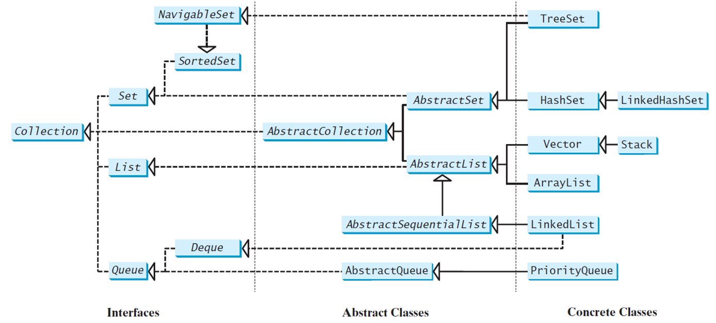
Java Collection Framework hierarchy (2 of 2)
Set and List are subinterfaces of Collection.
Notes:
The diagram is divided into three parts from left to right as interfaces, abstract classes, and concrete classes. In the interfaces NavigableSet leads to SortedSet which further leads to Set. Deque leads to Queue. Queue, list, and set together leads to Collection on the left. In abstract classes, AbstractSequentialList leads to AbstractList. AbstractList and AbstractSet lead to AbstractCollection which further leads to Collection on the left. Also, AbstractQueue leads to Queue. In concrete classes, LinkedHashSet leads to HashSet. TreeSet and HashSet lead to AbstractSet. Stack leads to Vector. ArrayList and Vector lead to AbstractList. LinkedList leads to AbstractSequentialList and Deque. PriorityQueue leads to Abstract Queue.

Slide 7
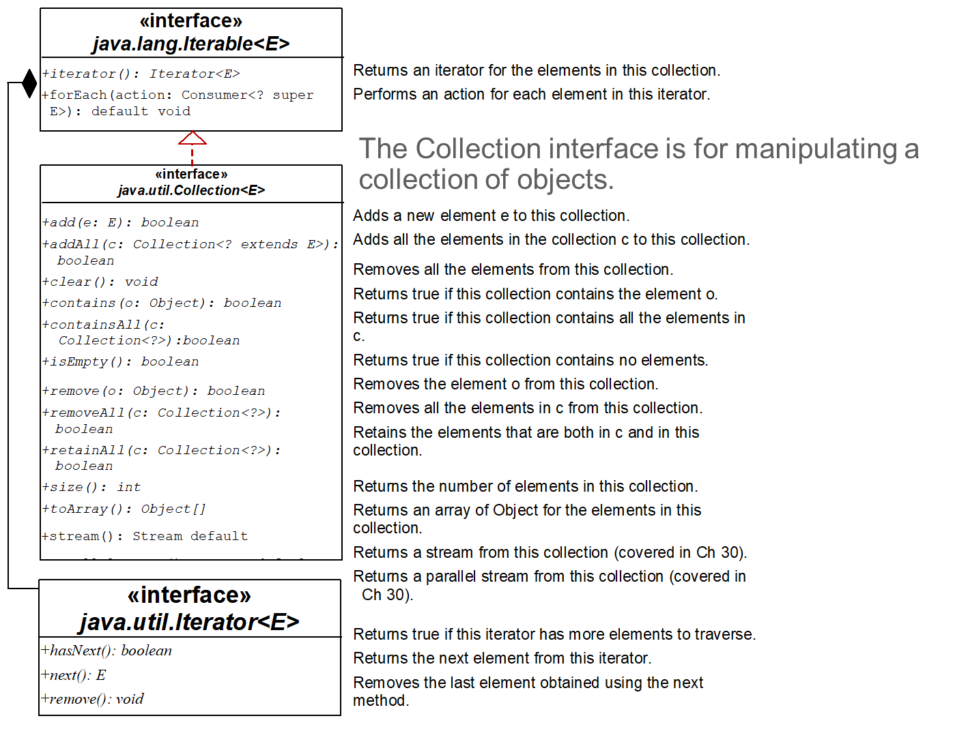
The Collection Interface
UML Diagram
TestCollection
Notes:
Collection less than symbol E greater than symbol and java.util.Iterator less than symbol E greater than symbol leading to the interface java.lang.Iterable less than symbol E greater than symbol. A shaded rhombus is attached to the java.lang.Iterable less than symbol E greater than symbol on the left. The code blocks for the three interfaces are as follows.
Interface
java.lang.Iterable less than symbol E greater than symbol
+iterator left parenthesis right parenthesis colon Iterator less than symbol E greater than symbol. Returns an iterator for the elements in this collection.
+forEach left parenthesis action colon Consumer less than symbol question mark super E greater than symbol right parenthesis colon default void. Performs an action for each element in this iterator.
Interface
java.util.Collection less than symbol E greater than symbol
+add left parenthesis e colon E right parenthesis colon Boolean. Adds a new element e to this collection.
+addAll left parenthesis c colon Collection less than symbol question mark extends E greater than symbol right parenthesis colon Boolean. Adds all the elements in the collection c to this collection.
+clear left parenthesis right parenthesis colon void. Removes all the elements from this collection.
+contains left parenthesis o colon Object right parenthesis colon Boolean. Returns true if this collection contains the element o.
+containsAll left parenthesis c colon Collection less than symbol question mark greater than symbol right parenthesis colon Boolean. Returns true if this collection contains all the elements in c.
+isEmpty left parenthesis right parenthesis colon Boolean. Returns true if this collection contains no elements.
+remove left parenthesis o colon Object right parenthesis colon Boolean. Removes the element o from this collection.
+removeAll left parenthesis c colon Collection less than symbol question mark greater than symbol right parenthesis colon Boolean. Removes all the elements in c from this collection.
+retainAll left parenthesis c colon Collection less than symbol question mark greater than symbol right parenthesis colon Boolean. Retains the elements that are both in c and in this collection.
+size left parenthesis right parenthesis colon int. Returns the number of elements in this collection.
+toArray left parenthesis right parenthesis colon Object left bracket right bracket. Returns an array of Object for the elements in this collection.
+stream left parenthesis right parenthesis colon Stream default. Returns a stream from this collection (covered in Ch 30).
+parallelStream left parenthesis right parenthesis colon Stream default. Returns a parallel stream from this collection (covered in Ch 30).
Interface
java.util.Iterator less than symbol E greater than symbol
+hasNext left parenthesis right parenthesis colon Boolean. Returns true if this iterator has more elements to traverse.
+next left parenthesis right parenthesis colon E. Returns the next element from this iterator.
+remove left parenthesis right parenthesis colon void. Removes the last element obtained using the next method.
UMLDiagram: https://liveexample.pearsoncmg.com/dsanimation/Figure20_2v2.html
TestCollection: https://liveexample.pearsoncmg.com/html/TestCollection.html

Slide 8
Iterators
Iterator is a classic design pattern for walking through a data structure without having to expose the details of how data is stored in the data structure.
TestIterator
Notes:
TestIterator: https://liveexample.pearsoncmg.com/html/TestIterator.html

Slide 9
Using the forEach Method
Java 8 added a new forEach method in the Iterable interface. It functions like a foreach loop.
TestForEach
Notes:
TestForEach: https://liveexample.pearsoncmg.com/html/TestForEach.html

Slide 10
The List Interface (1 of 2)
A list stores elements in a sequential order, and allows the user to specify where the element is stored. The user can access the elements by index.

Slide 11
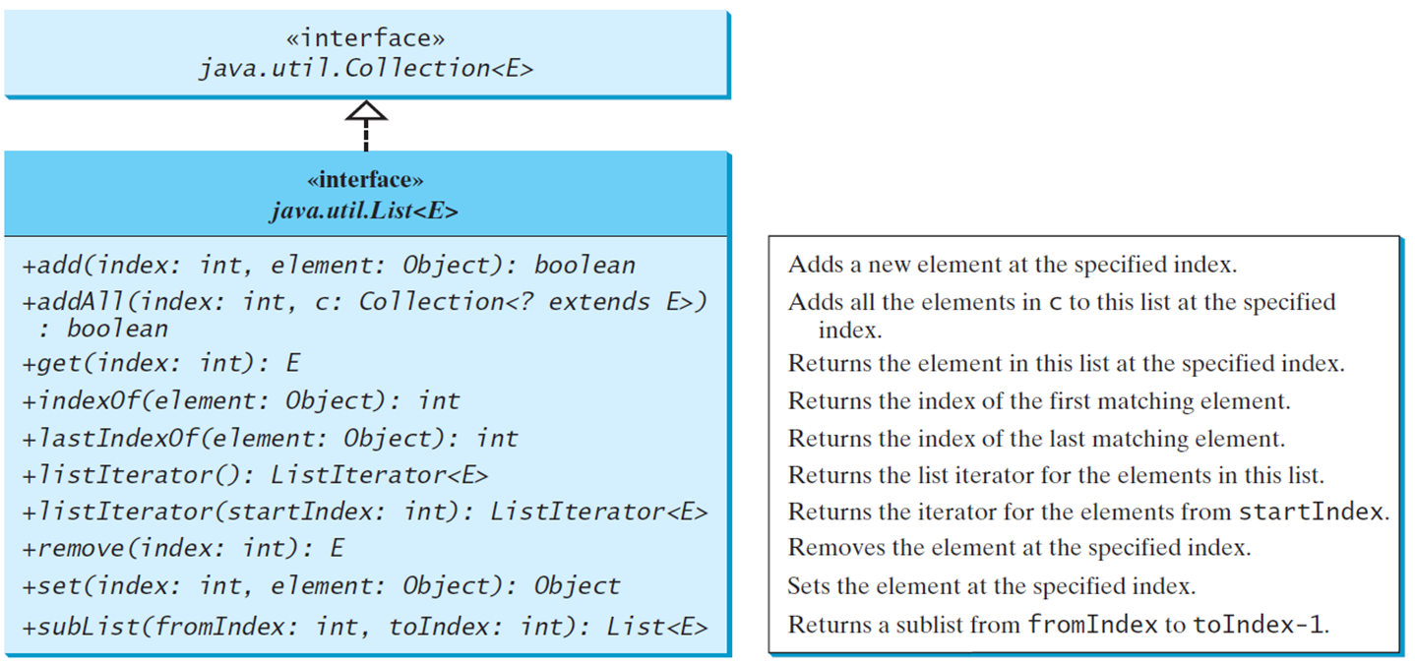
The List Interface (2 of 2)
Notes:
The codes and descriptions for the interface java.utiLList less than symbol E greater than symbol are as follows.
+add left parenthesis index colon int, element colon Object right parenthesis colon Boolean. Adds a new element at the specified index.
+addAll left parenthesis index colon int, c colon Collection less than symbol question mark extends E greater than symbol right parenthesis colon Boolean. Adds all the elements in c to this list at the specified index.
+get left parenthesis index colon int right parenthesis colon E. Returns the element in this list at the specified index.
+indexOf left parenthesis element colon Object right parenthesis colon int. Returns the index of the first matching element.
+lastIndexOffelement colon Object right parenthesis colon int. Returns the index of the last matching element.
+listIterator left parenthesis right parenthesis colon Listlterator less than symbol E greater than symbol. Returns the list iterator for the elements in this list.
+listIterator left parenthesis startIndex colon int right parenthesis colon Listlterator less than symbol E greater than symbol. Returns the iterator for the elements from start Index.
+remove left parenthesis index colon int right parenthesis colon E. Removes the element at the specified index.
+set left parenthesis index colon int, element colon Object right parenthesis colon Object. Sets the element at the specified index.
+subList left parenthesis fromIndex colon int, tolndex colon int right parenthesis colon List less than symbol E greater than symbol. Returns a sublist from fromIndex to toIndex, 1.

Slide 12
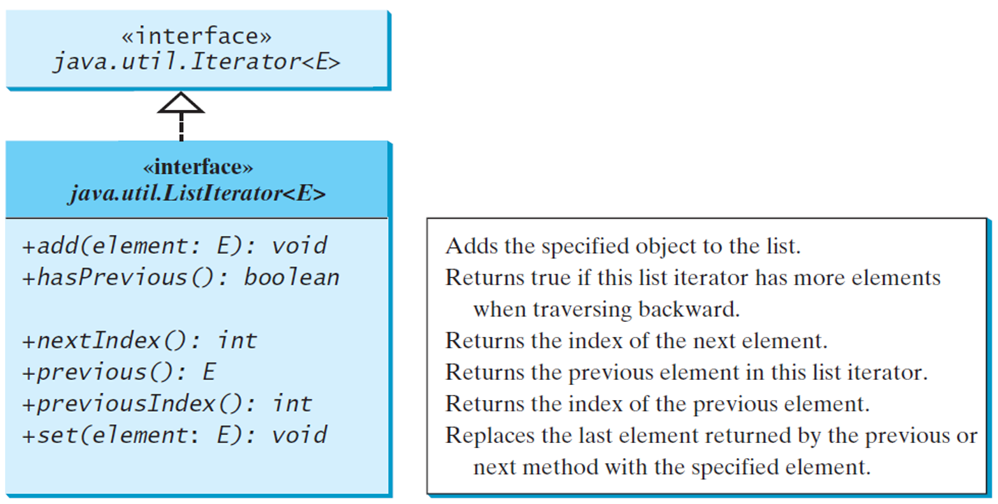
The List Iterator
Notes:
The codes and descriptions for the interface java.utiLListIterator less than symbol E greater than symbol are as follows.
+add left parenthesis element colon E right parenthesis colon void. Adds the specified object to the list.
+hasPrevious left parenthesis right parenthesis colon Boolean. Returns true if this list iterator has more elements when traversing backward.
+nextIndex left parenthesis right parenthesis colon int. Returns the index of the next element.
+previous left parenthesis right parenthesis colon E. Returns the previous element in this list iterator.
+previousIndex left parenthesis right parenthesis colon int. Returns the index of the previous element.
+set left parenthesis elementcolon E right parenthesis colon void. Replaces the last element returned by the previous or next method with the specified element.

Slide 13
ArrayList and LinkedList
The ArrayList class and the LinkedList class are concrete implementations of the List interface. Which of the two classes you use depends on your specific needs. If you need to support random access through an index without inserting or removing elements from any place other than the end, ArrayList offers the most efficient collection. If, however, your application requires the insertion or deletion of elements from the beginning of the list, you should choose LinkedList. A list can grow or shrink dynamically. An array is fixed once it is created. If your application does not require insertion or deletion of elements, the most efficient data structure is the array.

Slide 14
java.util.ArrayList
Notes:
java.util.List less than symbol E greater than symbol which further leads to the interface java.utiLCollection less than symbol E greater than symbol. The codes for java.util.ArrayList less than symbol E greater than symbol are as follows.
+AnayList right parenthesis. Creates an empty list with the default initial capacity.
+ArrayList left parenthesis c colon Collection less than symbol question amrk extends E greater than symbol right parenthesis. Creates an array list from an existing collection.
+ArrayList left parenthesis initialCapacity colon int right parenthesis. Creates an empty list with the specified initial capacity.
+trimToSize left parenthesis right parenthesis colon void. Trims the capacity of this ArrayList instance to be the list's current size.

Slide 15
java.util.LinkedList
Notes:
java.util.List less than symbol E greater than symbol which further leads to the interface java.util.Collection less than symbol E greater than symbol.
The codes for java.util.LinkedList less than symbol E greater than symbol are as follows.
+LinkedList left parenthesis right parenthesis. Creates a default empty linked list.
+LinkedList left parenthesis c colon Collection less than symbol question mark extends E greater than symbol right parenthesis. Creates a linked list from an existing collection.
+addFirst left parenthesis o colon E right parenthesis colon void. Adds the object to the head of this list.
+addLast left parenthesis o colon E right parenthesis colon void. Adds the object to the tail of this list.
+getFirst left parenthesis right parenthesis colon E. Returns the first element from this list.
+getLast left parenthesis right parenthesis colon E. Returns the last element from this list.
+removeFirst left parenthesis right parenthesis colon E. Returns and removes the first element from this list.
+removeLast left parenthesis right parenthesis colon E. Returns and removes the last element from this list.

Slide 16
Example: Using ArrayList and LinkedList
This example creates an array list filled with numbers, and inserts new elements into the specified location in the list. The example also creates a linked list from the array list, inserts and removes the elements from the list. Finally, the example traverses the list forward and backward.
TestArrayAndLinkedList
Notes:
TestArrayAndLinkedList: https://liveexample.pearsoncmg.com/html/TestArrayAndLinkedList.html

Slide 17
The Comparator Interface
You have learned to compare objects using the Comparable interface. What happens if the objects are not instances of Comparable. You can define a comparator to compare these elements.
The Comparator interface has the compare method for comparing two objects.

Slide 18
The Comparator<T> Interface
public int compare(T element1, T element2)
Returns a negative value if element1 is less than element2, a positive value if element1 is greater than element2, and zero if they are equal.
GeometricObjectComparator
TestCollection
Notes:
GeometricObjectComparator: https://liveexample.pearsoncmg.com/html/GeometricObjectComparator.html
TestCollection: https://liveexample.pearsoncmg.com/html/TestComparator.html

Slide 19
Using Lambda Expression in Comparator
Comparator is a functional interface. It has just a single method, compare. We can use lambda expression to simplify coding.

Slide 20
Other Comparator Examples
SortStringByLength
SortStringIgnoreCase
Notes:
SortStringByLength: https://liveexample.pearsoncmg.com/html/SortStringByLength.html
SortStringIgnoreCase: https://liveexample.pearsoncmg.com/html/SortStringIgnoreCase.html

Slide 21
Method Reference
String::compareToIgnoreCase
is known as method reference, which is equivalent to the lambda expression:
(s1, s2) -> s1.compareToIgnoreCase(s2)
The compiler automatically translates a method reference to an equivalent lambda expression.

Slide 22
The comparing Method
You can use the static comparing method in the Comparator interface to create a comparator.
For example, the following code sorts a list of loans based on their loan amount property.
Loan[] list = {new Loan(5.5, 10, 2323), new Loan(5, 10, 1000)};
Arrays.sort(list, Comparator.comparing(Loan::getLoanAmount));

Slide 23
Add Additional Sort Criteria
You can sort using a primary criteria, second, third, and so on using the Comparator’s default thenComparing method.
Loan[] list = {new Loan(5.5, 10, 100), new Loan(5, 10, 1000)};
Arrays.sort(list, Comparator.comparing(Loan::getLoanAmount)
.thenComparing(Loan::getAnnualInterestRate));

Slide 24
The Collections Class
The Collections class contains various static methods for performing common operations in a collection and a list.

Slide 25
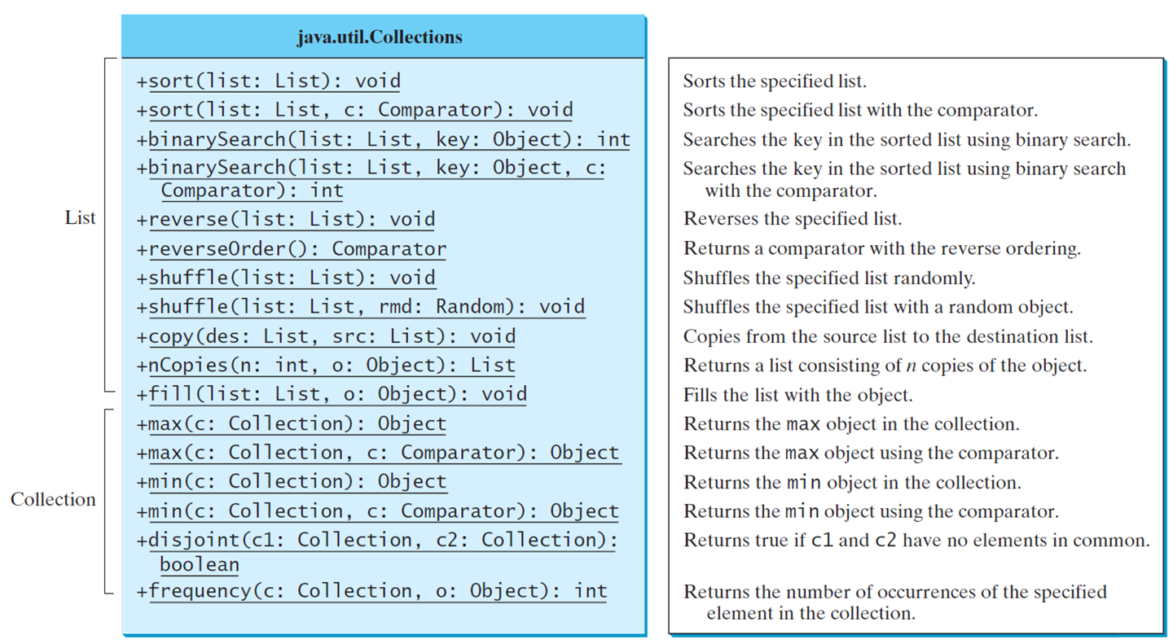
The Collections Class U M L Diagram
Notes:
+sort left parenthesis list colon List right parenthesis colon void. Sorts the specified list.
+sort left parenthesis list colon List, c colon Comparator right parenthesis colon void. Sorts the specified list with the comparator.
+binarySearch left parenthesis list colon List, key colon Object right parenthesis colon int. Searches the key in the sorted list using binary search.
+binarySearch left parenthesis list colon List, key colon Object, c colon Comparator right parenthesis colon int. Searches the key in the sorted list using binary search with the comparator.
+reverse left parenthesis list colon List right parenthesis colon void. Reverses the specified list.
+reverseOrder left parenthesis right parenthesis colon Comparator. Returns a comparator with the reverse ordering.
+shuffle left parenthesis list colon List right parenthesis colon void. Shuffles the specified list randomly.
+shuffle left parenthesis list colon List, rmd colon Random right parenthesis colon void. Shuffles the specified list with a random object.
+copy left parenthesis des colon List, src colon List right parenthesis colon void. Copies from the source list to the destination list.
+nCopies left parenthesis n colon int, o colon Object right parenthesis colon List Returns a list consisting of n copies of the object.
+fill left parenthesis list colon List, o colon Object right parenthesis colon void. Fills the list with the object.
+max left parenthesis c colon Collection right parenthesis colon Object. Returns the max object in the collection.
+max left parenthesis c colon Collection, c colon Comparator right parenthesis colon Object. Returns the max object using the comparator.
+min left parenthesis c colon Collection right parenthesis colon Object. Returns the mi n object in the collection.
+min left parenthesis c colon Collection, c colon Comparator right parenthesis colon Object. Returns the mi n object using the comparator.
+disjoint left parenthesis cl colon Collection, c2 colon Collection right parenthesis colon Boolean. Returns true if c1 and c2 have no elements in common.
+frequency left parenthesis c colon Collection, o colon Object right parenthesis colon int. Returns the number of occurrences of the specified element in the collection.

Slide 26
Case Study: Multiple Bouncing Balls
MultipleBounceBall
Notes:
A rhombus is attached to MultpleBallPane on the left. Another line connects MultpleBallPane to MultipleBounceBall with 1 near each end. Ball leads to javafx.scene.shape.Circle. The codes are as follows.
dx colon double
dy colon double
+Ball left parenthesis x colon double, y colon double, radius colon double, color colon Color right parenthesis
The MultipleBallPane leads to javafx.scene.layout.Pane. The codes are as follows.
animation colon Timeline
+MultipleBallPane left parenthesis right parenthesis
+play left parenthesis right parenthesis colon void
+pause left parenthesis right parenthesis colon void
+increaseSpeed left parenthesis right parenthesis colon void
+decreaseSpeed left parenthesis right parenthesis colon void
+rateProperty left parenthesis right parenthesis colon DoubleProperty
+moveBall left parenthesis right parenthesis colon void.
Also, MultipleBounceBall leads to javafx.application.Application.
MultipleBounceBall: https://liveexample.pearsoncmg.com/html/MultipleBounceBall.html

Slide 27
The Vector and Stack Classes
The Java Collections Framework was introduced with Java 2. Several data structures were supported prior to Java 2. Among them are the Vector class and the Stack class. These classes were redesigned to fit into the Java Collections Framework, but their old-style methods are retained for compatibility. This section introduces the Vector class and the Stack class.

Slide 28
The Vector Class (1 of 2)
The Vector class is replaced by the ArrayList.
Vector contains the synchronized methods for accessing and modifying the vector. It is not efficient for most of the applications.
You may encounter Vector in the legacy Java code.

Slide 29
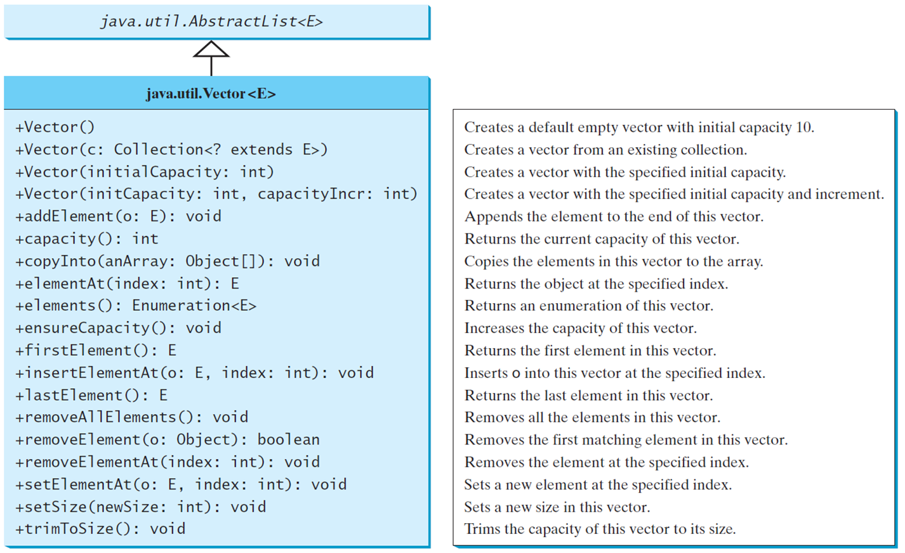
The Vector Class (2 of 2)
Notes:
The codes and descriptions for java.util.Vector less than symbol E greater than symbol are as follows.
+Vector left parenthesis right parenthesis. Creates a default empty vector with initial capacity 10.
+Vector left parenthesis c colon Collection question extends E greater than symbol right parenthesis. Creates a vector from an existing collection.
+Vector left parenthesis initialCapacity colon int right parenthesis. Creates a vector with the specified initial capacity.
+Vector left parenthesis initCapacity colon int, capacityIncr colon int right parenthesis. Creates a vector with the specified initial capacity and increment.
+addElement left parenthesis o colon E right parenthesis colon void. Appends the element to the end of this vector.
+capacity left parenthesis right parenthesis colon int. Returns the current capacity of this vector.
+copyInto left parenthesis anArray colon Object left bracket right bracket right parenthesis colon void. Copies the elements in this vector to the array.
+elementAt left parenthesis index colon int right parenthesis colon E. Returns the object at the specified index.
+elements left parenthesis right parenthesis colon Enumeration less than symbol E greater than symbol. Returns an enumeration of this vector.
+ensureCapacity left parenthesis right parenthesis colon void. Increases the capacity of this vector.
+firstElement left parenthesis right parenthesis colon E. Returns the first element in this vector.
+insertElementAt left parenthesis o colon E, index colon int right parenthesis colon void. Inserts o into this vector at the specified index.
+lastElement left parenthesis right parenthesis colon E. Returns the last element in this vector.
+removeAllElements left parenthesis right parenthesis colon void. Removes all the elements in this vector.
+removeElement left parenthesis o colon Object right parenthesis colon Boolean. Removes all the elements in this vector.
+removeElementAt left parenthesis index colon int right parenthesis colon void. Removes the element at the specified index.
+setElementAt left parenthesis o colon E, index colon int right parenthesis colon void. Sets a new element at the specified index.
+setSize left parenthesis newSize colon int right parenthesis colon void. Sets a new size in this vector.
+trimToSize left parenthesis right parenthesis colon void. Trims the capacity of this vector to its size.

Slide 30
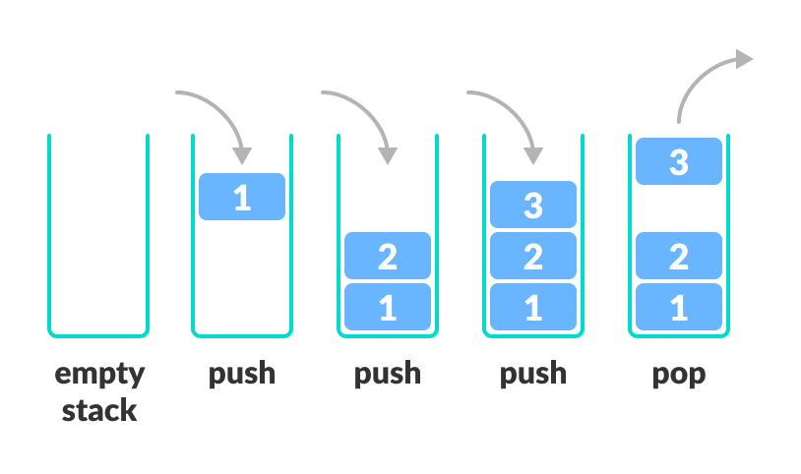
The Stack Class
The Stack class represents a last-in-first-out stack of objects. The elements are accessed only from the top of the stack. You can retrieve, insert, or remove an element from the top of the stack.
Notes:
The codes and descriptions for java.util.Stack less than symbol E greater than symbol are as follows.
+Stack left parenthesis right parenthesis. Creates an empty stack.
+empty left parenthesis right parenthesis colon Boolean. Returns true if this stack is empty.
+peek left parenthesis right parenthesis colon E. Returns the top element in this stack.
+pop left parenthesis right parenthesis colon E. Returns and removes the top element in this stack.
+push left parenthesis o colon E right parenthesis colon E. Adds a new element to the top of this stack.
+search left parenthesis o colon Object right parenthesis colon int. Returns the position of the specified element in this stack.

Slide 31
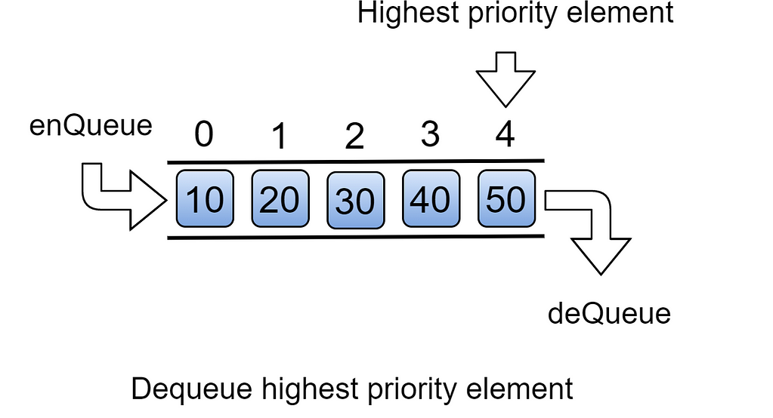
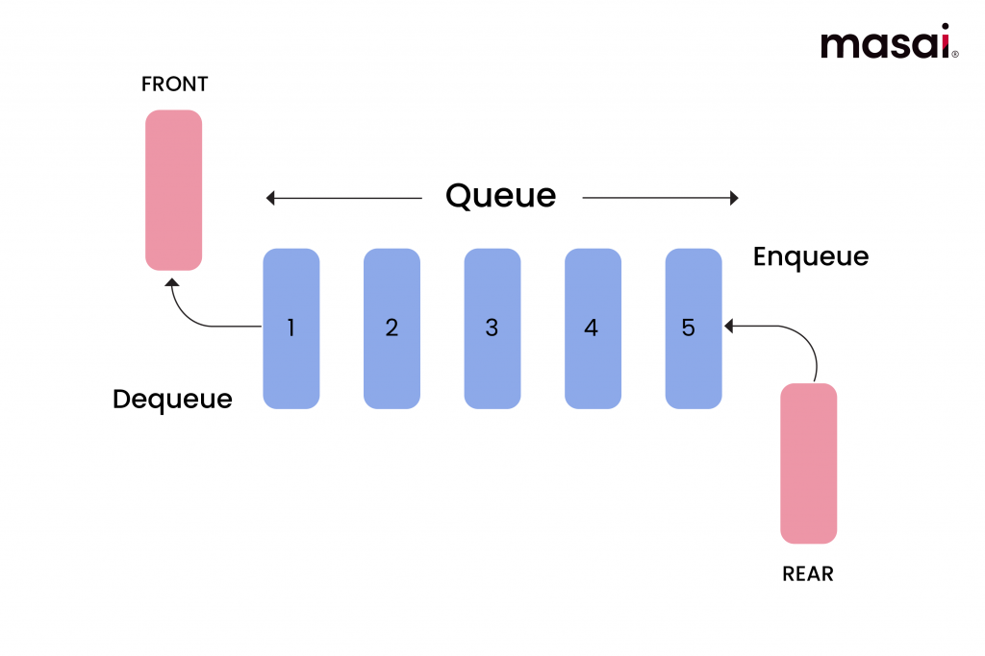
Queues and Priority Queues
A queue is a first-in/first-out data structure. Elements are appended to the end of the queue and are removed from the beginning of the queue. In a priority queue, elements are assigned priorities. When accessing elements, the element with the highest priority is removed first.

Slide 32
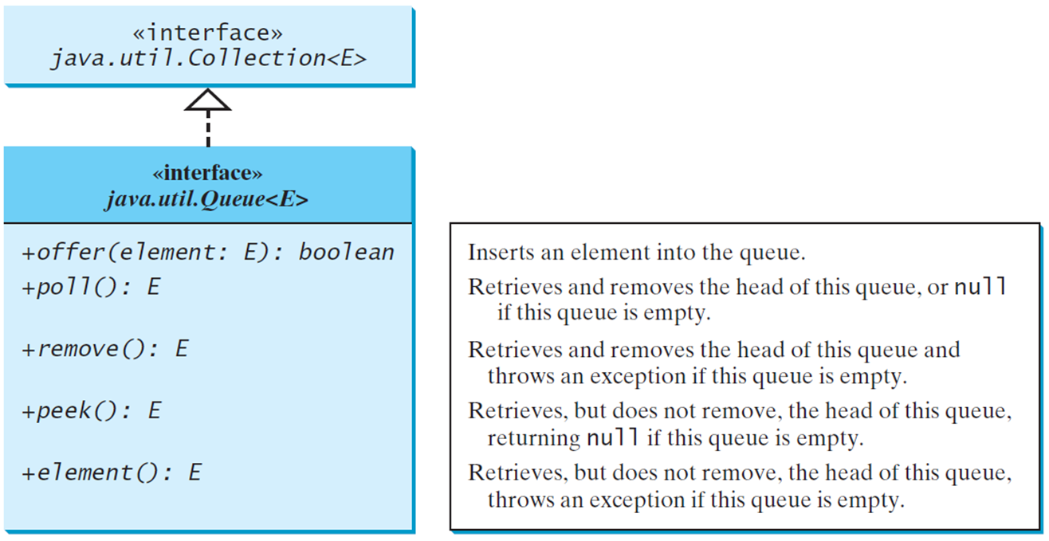
The Queue Interface
Notes:
The codes and descriptions for the interface Java.util.Queue less than symbol E greater than symbol are as follows.
+offer left parenthesis element colon E right parenthesis colon Boolean. Inserts an element into the queue.
+poll left parenthesis right parenthesis colon E. Retrieves and removes the head of this queue, or null if this queue is empty.
+remove left parenthesis right parenthesis colon E. Retrieves and removes the head of this queue and throws an exception if this queue is empty.
+peek left parenthesis right parenthesis colon E. Retrieves, but does not remove, the head of this queue, returning null if this queue is empty.
+element left parenthesis right parenthesis colon E. Retrieves, but does not remove, the head of this queue, throws an exception if this queue is empty.

Slide 33
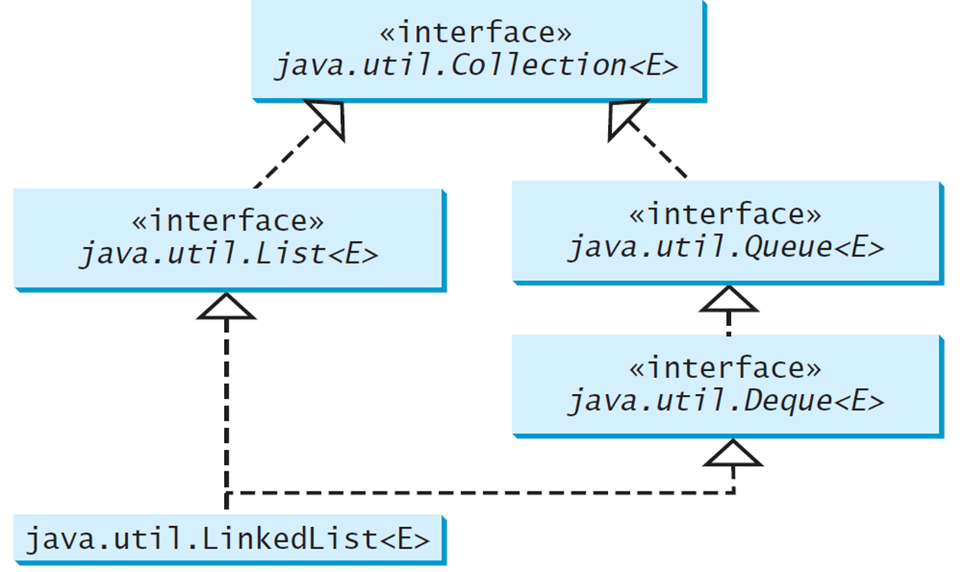
Using LinkedList for Queue
Notes:
E greater than symbol and interface java.util.Deque less than symbol E greater than symbol. The interface java.util.Deque less than symbol E greater than symbol leads to interface java.util.Queue less than symbol E greater than symbol. The interface java.util.Collection less than symbol E greater than symbol and interface java.util.Queue less than symbol E greater than symbol leads to interface java.util.Collection less than symbol E greater than symbol.

Slide 34
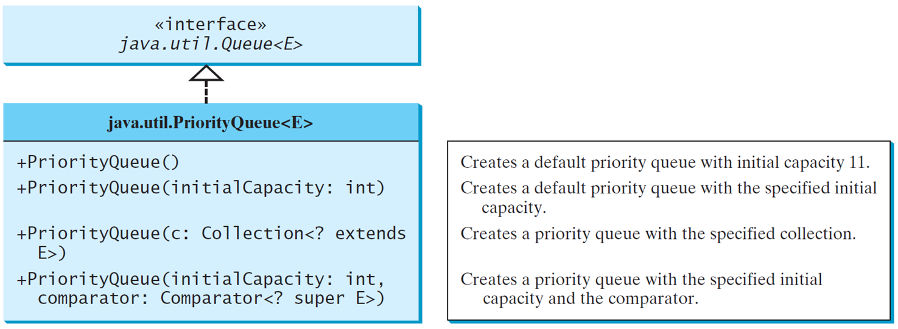
The PriorityQueue Class
PriorityQueueDemo
Notes:
The codes and description for java.util.PriorityQueue less than symbol E greater than symbol are as follows.
+PriorityQueue left parenthesis right parenthesis. Creates a default priority queue with initial capacity 11.
+PriorityQueue left parenthesis initialCapacity colon int right parenthesis. Creates a default priority queue with the specified initial capacity.
+PriorityQueue left parenthesis c colon Coll ection less than symbol question mark extends E greater than symbol right parenthesis. Creates a priority queue with the specified collection.
+PriorityQueue left parenthesis initialCapacity colon int, comparator colon Comparator less than symbol question mark super E greater than symbol right parenthesis. Creates a priority queue with the specified initial capacity and the comparator.
PriorityQueueDemo: https://liveexample.pearsoncmg.com/html/PriorityQueueDemo.html

Slide 35
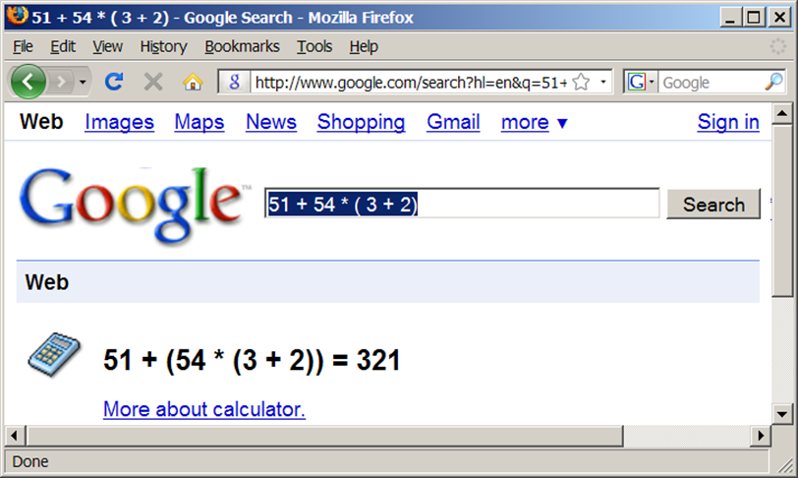
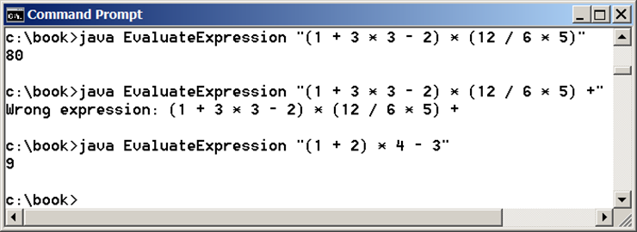
Case Study: Evaluating Expressions
Stacks can be used to evaluate expressions.
Evaluate Expression
Notes:
Evaluate Expression:: https://liveexample.pearsoncmg.com/html/EvaluateExpression.html

Slide 36
Algorithm
Phase 1: Scanning the expression
The program scans the expression from left to right to extract operands, operators, and the parentheses.
1.1. If the extracted item is an operand, push it to operandStack.
1.2. If the extracted item is a + or - operator, process all the operators at the top of operatorStack and push the extracted operator to operatorStack.
1.3. If the extracted item is a * or / operator, process the * or / operators at the top of operatorStack and push the extracted operator to operatorStack.
1.4. If the extracted item is a ( symbol, push it to operatorStack.
1.5. If the extracted item is a ) symbol, repeatedly process the operators from the top of operatorStack until seeing the ( symbol on the stack.
Phase 2: Clearing the stack
Repeatedly process the operators from the top of operatorStack until operatorStack is empty.

Slide 37
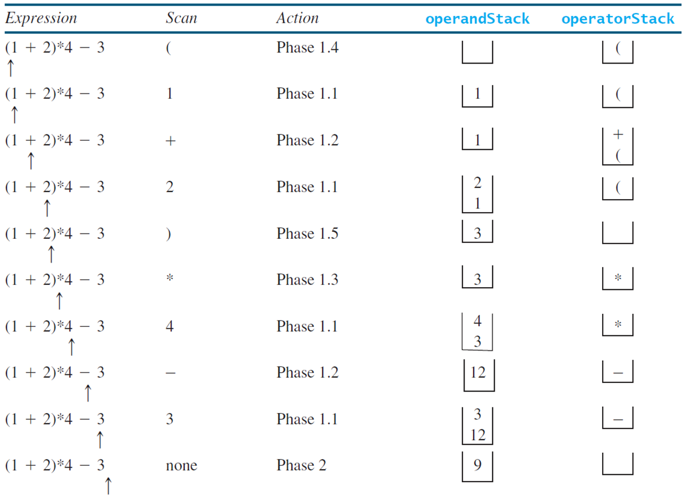
Example
Notes:
Row 1. Left parenthesis 1 + 2 right parenthesis times 4 minus 3, left parenthesis, Phase 1.4, blank, left parenthesis. An arrow points to left parenthesis in the first column.
Row 2. Left parenthesis 1 + 2 right parenthesis times 4 minus 3, 1, Phase 1.1, 1, left parenthesis. An arrow points to 1.
Row 3. left parenthesis 1 + 2 right parenthesis times 4 minus 3, +, Phase 1.2, 1, + left parenthesis. An arrow point to + in the first column.
Row 4. left parenthesis 1 + 2 right parenthesis times 4 minus 3, 2, Phase 1.1, 2 and 1, left parenthesis. An arrow points to 2 in the first column.
Row 5. left parenthesis 1 + 2 right parenthesis times 4 minus 3, right parenthesis, Phase 1.5, 3, blank. An arrow points to right parenthesis in the first column.
Row 6. left parenthesis 1 + 2 right parenthesis times 4 minus 3, times, Phase 1.3, 3, times. An arrow points to times in the first column.
Row 7. left parenthesis 1 + 2 right parenthesis times 4 minus 3, 4, Phase 1.1, 4 and 3, times. An arrow points to 4 in the first column.
Row 8. left parenthesis 1 + 2 right parenthesis times 4 minus 3, minus, Phase 1.2, 12, minus. An arrow points to minus sign in the first column.
Row 9. Left parenthesis 1 + 2 right parenthesis times 4 minus 3, Phase 1.1, 3 and 12, minus. An arrow points to 3 in the first column.
Row 10. left parenthesis 1 + 2 right parenthesis times 4 minus 3, none, Phase 2, 9, blank. An arrow points to space next to 3 in the first column.

Slide 38

Copyright
This work is protected by United States copyright laws and is provided solely for the use of instructors in teaching their courses and assessing student learning. Dissemination or sale of any part of this work (including on the World Wide Web) will destroy the integrity of the work and is not permitted. The work and materials from it should never be made available to students except by instructors using the accompanying text in their classes. All recipients of this work are expected to abide by these restrictions and to honor the intended pedagogical purposes and the needs of other instructors who rely on these materials.

